Slide 1
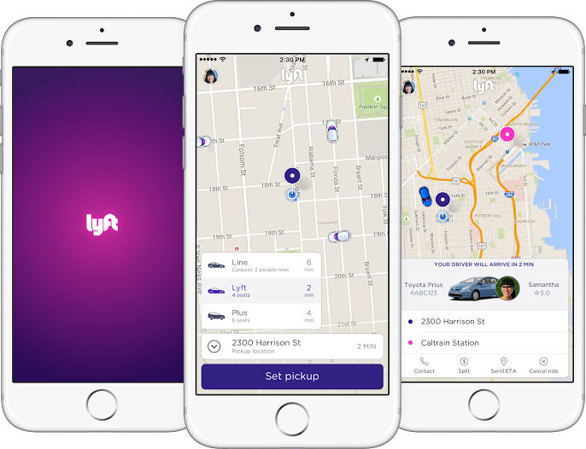
How Lyft Works
Request a ride at the touch of a button
Upfront pricing
No cash required
Tip your driver in the app
30% more affordable than a taxi
Safety features built right into the App

Slide 2
Policies that Protect Drivers and Passengers
Safe drivers:
Rigorous rolling criminal background and driving record checks
Zero tolerance drug/alcohol policy
Real-time ratings
Vehicle standards and age requirements
Insurance protection plan
24/7 Critical Response Line

Slide 3
Policies that Protect Drivers and Passengers
Protections for Passengers:
App shows driver photo, vehicle type, and license plate number
App displays rider name in the vehicle
Ability to share live ride information with Friends and Family
Emailed receipt with route and travel information
24/7 Trust & Safety Team

Slide 4
Get the Lyft App
Use your phone to go to your app store (the iOS App Store for iPhone and Google Play Store for Androids)

Slide 5
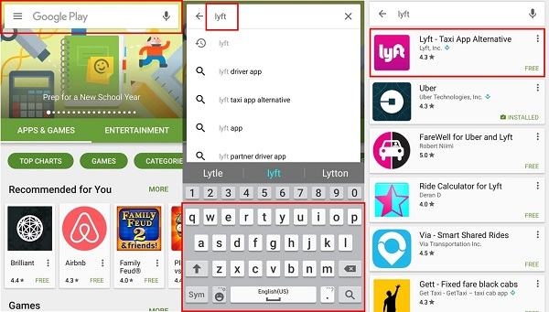
Find Lyft in Google Play
Tap the Search box at the top of the screen and use your keyboard to type in “Lyft”.
You will see a Lyft box come to the top of your screen. Tap that.

Slide 6
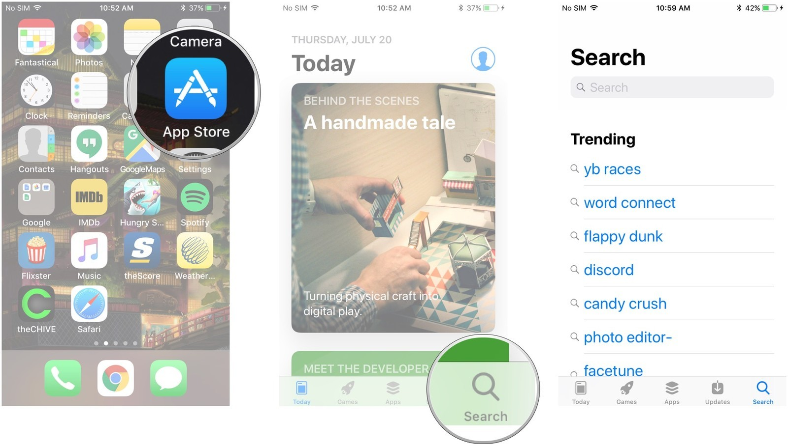
Find Lyft in App Store
Tap Search Icon at bottom of screen and use your keyboard to type in “Lyft” in the Search Bar

Slide 7
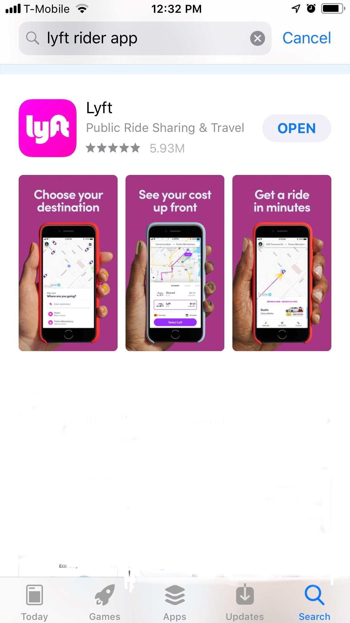
Install the Lyft App
On the new screen, tap the Install button
On Apple device, tap Get and then Install

Slide 8
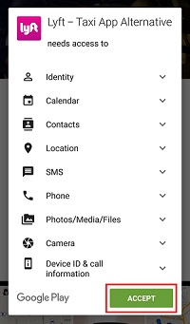
Accept Lyft Onto Your Phone
On an Android device, you will be notified of what parts of your phone the Lyft app might need access to in order to function properly. Tap Accept.
On Apple device you may be asked to log into your Apple Account before you go any further. Do so, or if you don’t have an Apple Account, we can help you set it up – appleid.apple.com

Slide 9
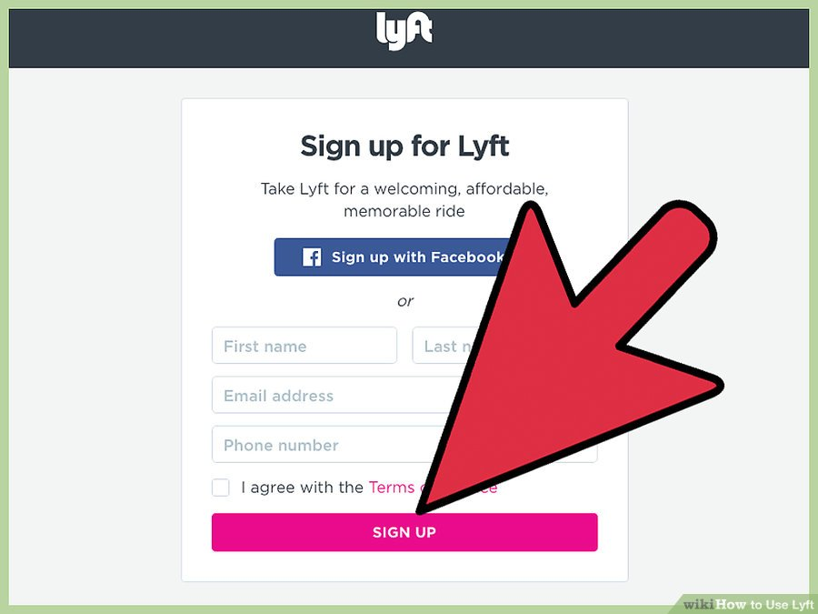
Sign Up with Lyft
Tap the Sign Up button. You’ll be taken to the account creation screen. Enter your first and last name, as well as your email address, and tap "Next."

Slide 10
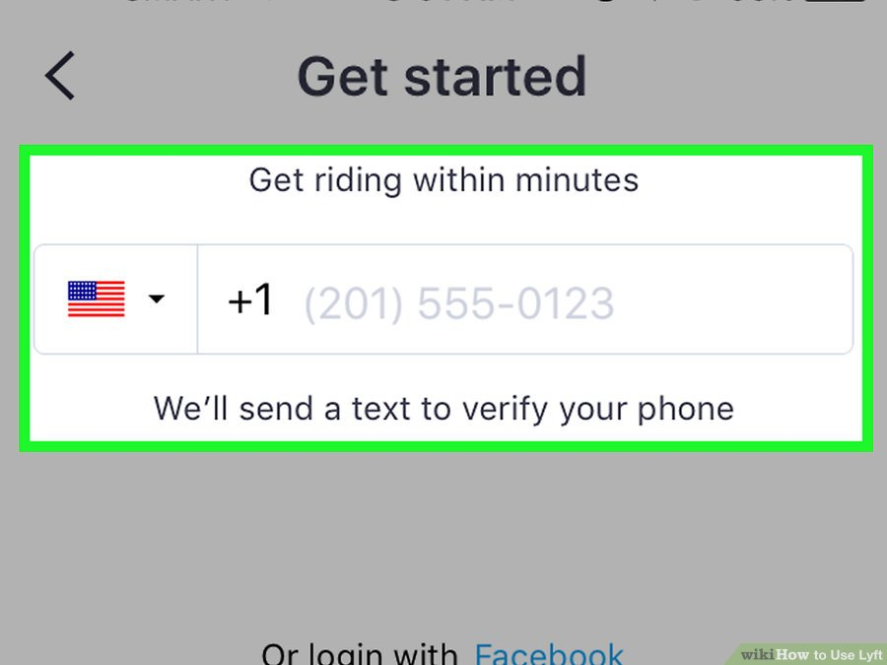
Enter Your Phone Number
Your phone's number will be displayed. Your phone must be a mobile phone and be able to receive SMS messages.

Slide 11
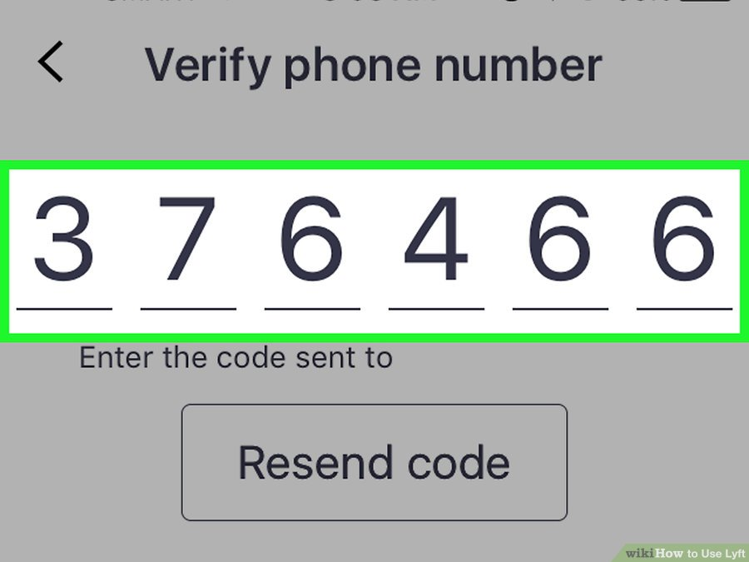
Verify Your Account
Enter the code that is texted to your phone. You will be prompted to enter the six-digit code that is sent to your number via SMS. This will verify your number and activate your account.

Slide 12
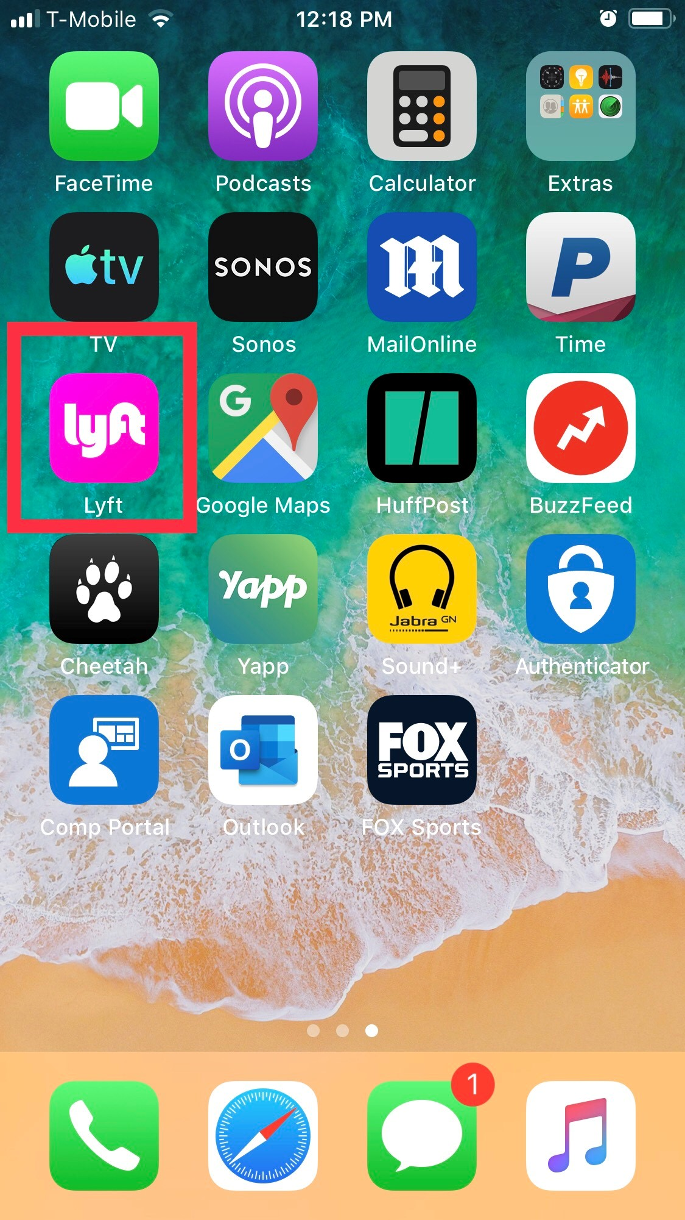
Add a Payment Method
Open the Lyft app. If the app isn't open already, you'll need to open Lyft to add a payment method.

Slide 13
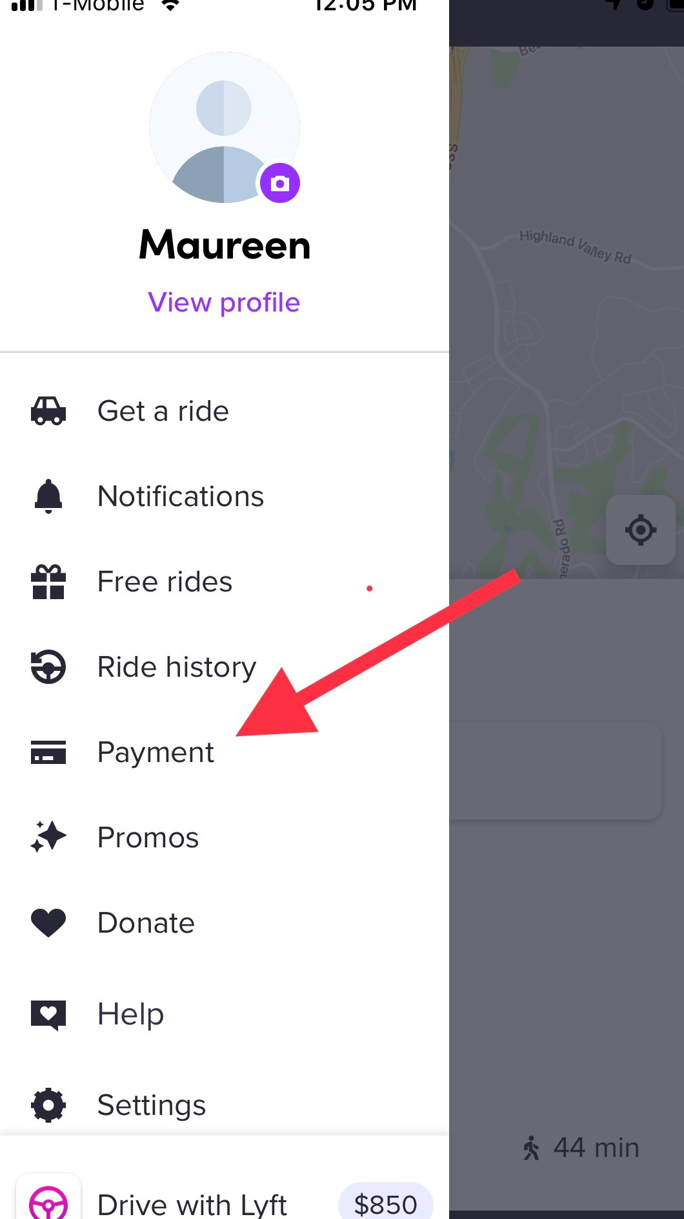
Payment Method
Tap the Menu button (☰). You can find this in the upper-left corner.
Select "Payment." This will display a list of payment method options.

Slide 14
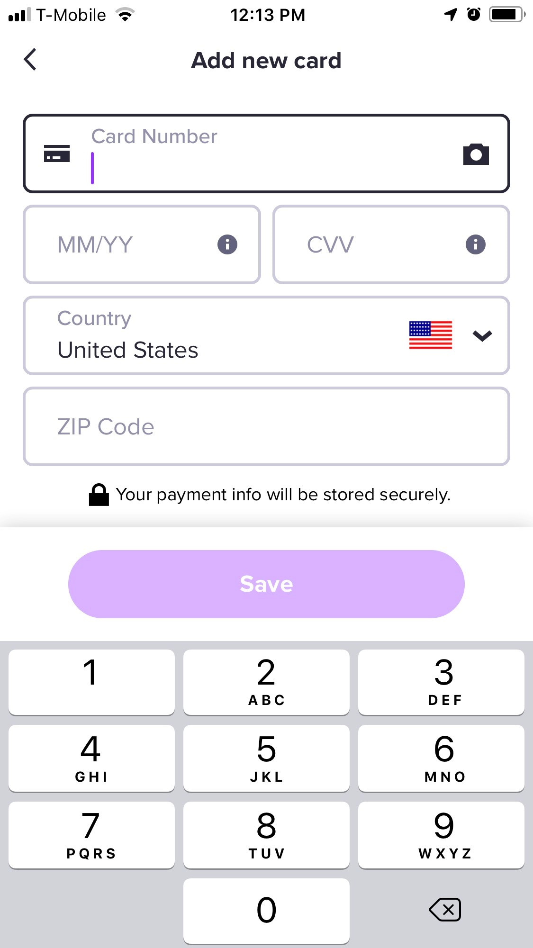
Payment Method
Tap a payment method to add it. Depending on the device you are using, you will have several payment options to pick from. Tap the one that you want to add. You can add multiple payment methods to the same account. Google Wallet/Apple Pay - These payment methods are only available on Android or iOS, respectively. You'll be able to link your account and pay directly from your Google Wallet or Apple Pay account.
PayPal - If you have a PayPal account, you can link it to Lyft and process your payments through it.
Credit card - You can add a Visa, MasterCard, American Express or Discover credit card, or a debit card that is tied to a checking account. You cannot use prepaid or virtual debit cards. You can add multiple cards to your account.
Lyft credit code - If you received Lyft credit as a gift, you can enter the code to activate your ride credit in PROMOS. We have credits for you!

Slide 15
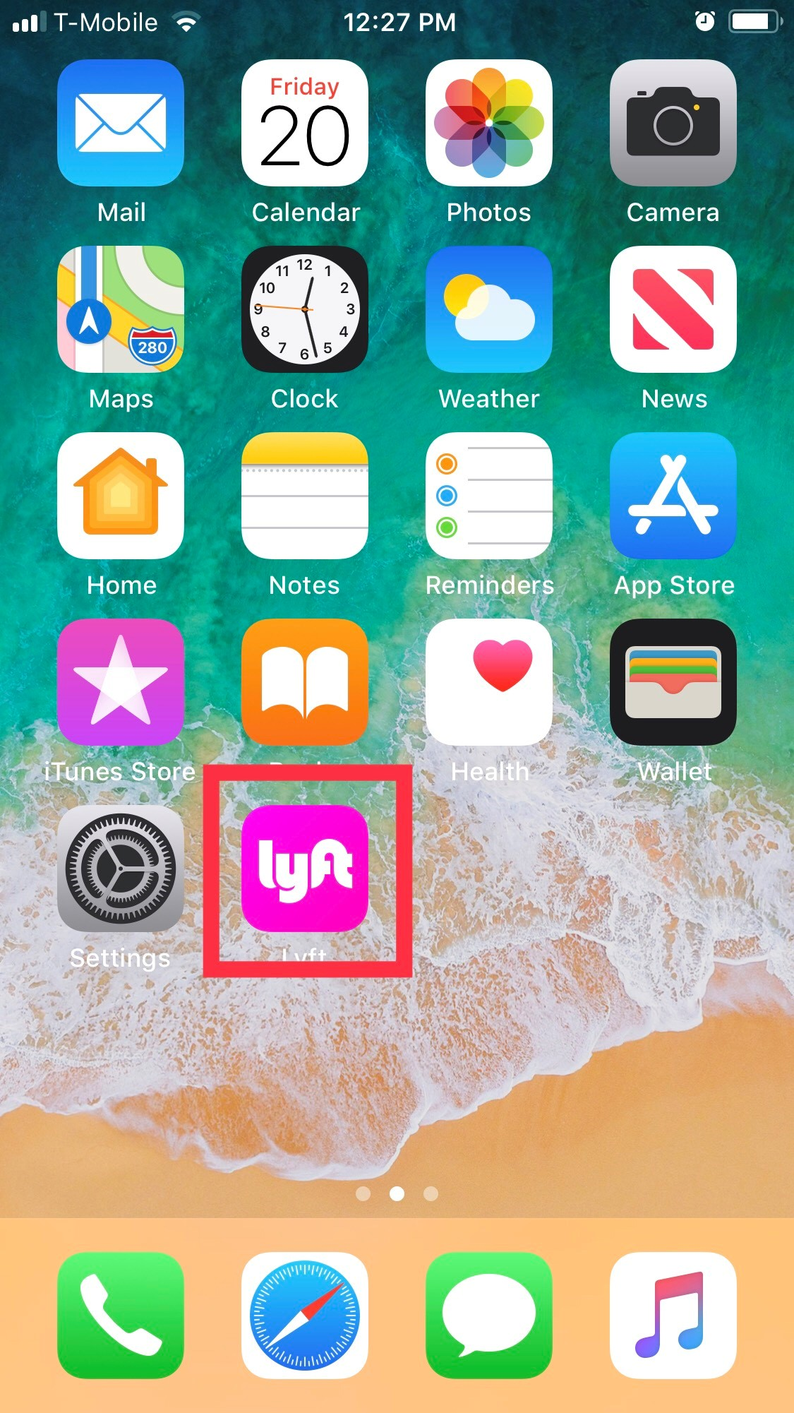
Get a Ride!
The location services on you phone must be turned on:
Apple go to Settings. Tap Privacy. Tap Location Services. Tap On button.
Android go to Apps. Tap Settings. Tap Location. Tap On at top of screen.
Open the Lyft app. You must use the Lyft app to request a ride. You cannot request a ride from a computer or from a web browser. Login with your Lyft account if you aren't already.

Slide 16
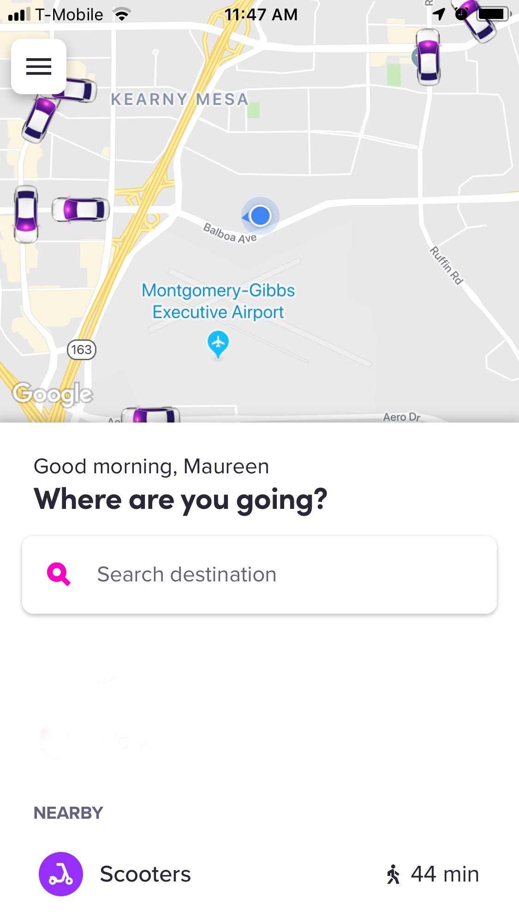
Set Your Pick-Up
The pickup location will automatically set to your current GPS location. To change the pickup location:
Tap “Search Destination”
Tap 'Current Location' at the top of the screen and enter an address; OR
Tap “Set on Map” at the bottom of the page and move the pin drop to where you want to be picked up (backdoor, driveway etc.)
Tap 'Set Pickup.'

Slide 17
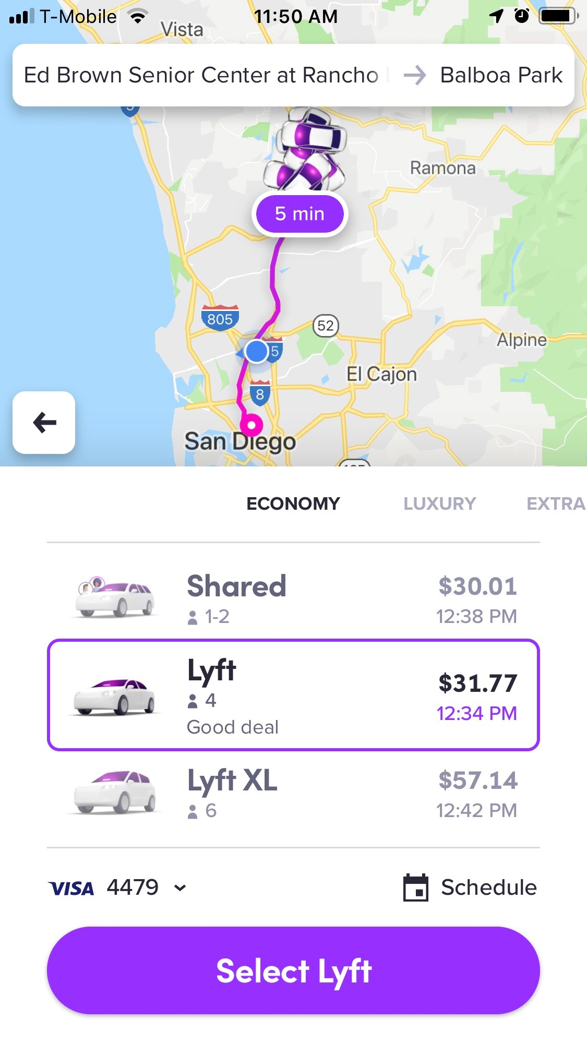
Set Your Destination and Ride Mode
Tap 'search destination' and enter your destination. You can enter an address or search for a location.
Select your ride mode. Swipe left for economy, luxury, or extra seating options.
Tap 'Select Lyft' to request a ride.
You’re ready to go! Make sure you are outside and visible to your driver.
You can watch your driver’s progress on your phone.

Slide 18
Reminder Policies that Protect Passengers
Protections for Passengers:
App shows driver photo, vehicle type, and license plate number
App displays rider name in the vehicle
Ability to share live ride information with Friends and Family
Emailed receipt with route and travel information
24/7 Trust & Safety Team

