Slide 1
Toolkit Instructions
The goal of this presentation template is for ACL Falls Prevention Grantees to emphasize to partners and workshop facilitators the importance of data collection and to provide instructions about how to submit the data collection forms.
Materials: PowerPoint presentation template and script
Overview
ACL/AoA Falls Prevention Grant Goals and Anticipated Results
Importance of Collecting Data
Data Collection Terminology and Forms
Instructions for Submitting Data Forms to Grantee
Maximizing Complete and Accurate Data
Participant Demographics and Program Outcomes Reports
Resources

Slide 2
Falls Prevention Data Collection Toolkit
Notes:
Note to ACL grantees: The term “agency” in this presentation refers to the agency/organization/foundation that was awarded a grant from the Administration for Community Living.

Slide 3
Grant Goals
Significantly increase the number of older adults and adults with disabilities at risk of falls who participate in evidence-based community programs to reduce falls and falls risks
Implement innovative funding arrangements to support evidence-based falls prevention program(s) both during and beyond the grant period; and,
Embed program(s) into an integrated, sustainable evidence-based prevention program network via centralized, coordinated processes
Notes:
In [year], [agency] was awarded a [# of years of grant] grant from the Administration for Community Living/Administration on Aging (ACL), Department of Health and Human Services to implement and sustain evidence-based community falls prevention programs.
The National Council on Aging (NCOA) is a respected national leader and trusted partner to help people aged 60+ meet the challenges
of aging. The National Council on Aging’s National Falls Prevention Resource Center, funded by ACL, provides technical support to implement and sustain evidence-based falls prevention programs, and manages the National Falls Prevention Database, where [insert agency] enters our grant data.
The grant goals are…

Slide 4
Anticipated Results
Reach [x] participants through the [x] program, [insert program description]
Reach [x] participants through the [x] program, [insert program description]
Reach [x] participants through the [x] program, [insert program description]
[Agency] requires program implementation sites to administer participant pre- and post-survey data to track participant engagement and program outcomes. Completing the forms is entirely voluntary for participants. They may choose to skip certain questions or choose not to complete the form at all.
For more information about the grant goals, activities, partnerships, and anticipated results, view the [state] grantee profile: https://www.ncoa.org/center-for-healthy-aging/falls-resource-center/falls-prevention-grantees-falls-resource-center/falls-prevention-grantee-profiles/
Notes:
The anticipated results include…
[Agency] requires program implementation sites to collect participant pre- and post-survey data. Completing the forms is entirely voluntary for participants. They may choose to skip certain questions or choose not to complete the form at all.
For more information about our grant goals, activities, partnerships, and anticipated results, view the [state] grantee profile: https://www.ncoa.org/center-for-healthy-aging/falls-resource-center/falls-prevention-grantees-falls-resource-center/falls-prevention-grantee-profiles/

Slide 5
Importance of Collecting Data
The Administration for Community Living, the National Council on Aging, and [insert agency here] use data to:
Determine program reach and participant demographics (i.e., ethnicity, age, gender) so we can better target our efforts to serve our community.
Report participant outcomes to determine the impact and value of the programs.
Show grant funding agency and legislators that they are spending their money wisely on these programs.
Learn what technical assistance we can provide to better support you in implementing and sustaining programs.
Inform future program needs.
Conduct research to determine the reach and value of programs.

Slide 6
Data Collection Form Terminology
Program: An evidence-based falls prevention program
Workshop: A class or group meeting through which a program is delivered to participants
Session: A single meeting of a workshop, e.g., an hour-long class period or an encounter
Facilitators/Leaders: The people who are trained to deliver the falls prevention programs
Participant: The people who enroll in the programs

Slide 7
Data Collection Form Terminology
Host Organizations: The organizations that sponsor workshops, hold the license for a programs, train or employ leaders, and arrange for the use of implementation sites
Implementation Sites: The physical locations where programs are delivered

Slide 8
Data Collection Forms
Host organization information form
Falls program information cover sheet
Falls program leader data collection script
Participant attendance log
Participant information form (pre-survey)
Participant post-session survey
All forms can be downloaded at the following webpage: [Insert your agency’s webpage, or link to the forms on the National Falls Prevention Grantee Resources webpage: https://www.ncoa.org/center-for-healthy-aging/falls-resource-center/falls-prevention-grantees-falls-resource-center/falls-prevention-grantees/]
Notes:
Host Organization Information Form: The purpose of the Host Organization Information Form is to collect information about host organizations and program(s) offered.
Program Information Cover Sheet: The purpose of the Information Cover Sheet is to collect data about the Falls Prevention Program offered, type of site, leader/instructor/coach information, and start and end dates.
Falls program leader data collection script: The Group Leader Script is designed to be read/paraphrased to program participants prior to their completion of the Participant Information Survey to explain the purpose of the data collection and its voluntary nature.
Attendance log: This log serves to capture the number of sessions or intervention dose that each Falls Prevention Program participant is completing. This log should be filled in by the person delivering the program (e.g. leader/instructor/coach etc.).
Participant Information Form (Pre-Survey): The purpose of the Participant Information Form is to collect participant demographics, health and disability status, falls history, risk factors, and outcomes information before a participant begins a falls prevention program.
Post-Session Survey: Use this survey to evaluate your falls prevention program.

Slide 9
Data Collection Forms Available in Multiple Languages
English
Spanish
Chinese
Hmong
Korean
Vietnamese
Cambodian (Khmer)

Slide 10
Instructions for Submitting the Data Forms
Compile the host organization information form, falls program information cover sheet, attendance log, participant pre-surveys, and participant post-surveys.
Within [timeframe, i.e. two weeks] of completing a program workshop, send all of the data forms to [agency] by:
[Insert your agency’s centralized data collection instructions here, i.e. scan and email the forms to example@ncoa.org]
Notes:
Note to ACL grantees: Modify this slide to include instructions for program facilitators to submit data collection forms.

Slide 11
Maximizing Complete and Accurate Data
Build in time to complete forms during the beginning of the first and last workshop sessions.
Review the Program Leader script that highlights the importance of completing the forms.
Host a “Session Zero” to allow participants more time to complete the pre-survey. Tools and tips sheets for hosting a Session Zero can be found here: https://www.ncoa.org/center-for-healthy-aging/cdsme-best-practices-toolkit/centralized-coordinated-logistical-processes/#intraPageNav1
Walk through the surveys together with the participant.
Notes:
Having complete and accurate data is the best way to paint a true picture of program performance in the field. Good data helps us learn how different programs impact people from a variety of backgrounds and across multiple settings.
Build in time to complete forms during the beginning of the first and last workshop sessions. This is essential as it shows participants that the forms are important enough to be integrated into the time allotted. This approach is also a more effective way to get responses than waiting until when people are ready to leave.
Review the Program Leader script that highlights the importance of completing the forms. Scripts for falls prevention and CDSME programs focus on the importance of participant feedback for improving future programs and obtaining funding, along with the fact that all information is confidential.
Host a “Session Zero” to allow participants more time to complete the pre-survey. If you are holding an orientation or recruitment event, carve in extra time to have newly enrolled participants complete baseline/pre-program forms
Walk through the surveys together. It may be worthwhile to walk through each question as a group to ensure that participants understand each question and accurately answer each one.

Slide 12
Maximizing Data Collection: Addressing Barriers
Have bilingual assistance to translate questions not easily understood, or be available to help with form completion. Note that the data collection forms are available in English, Spanish, Cambodian, Chinese, Hmong, Korean, and Vietnamese.
For questions with scales, consider creating large laminated print cards depicting the scales.
For questions asking about a timeframe, e.g., ‘number of falls in the past 3 months’, help the group by giving a time frame.
Bring a few extra copies of the forms printed with large font (size 16 or larger) for individual with visual impairment.
Have 2-3 volunteers walk around and assist participants with form completion.
Notes:
The data collection forms are available in English, Spanish, Cambodian, Chinese, Hmong, Korean, and Vietnamese.
Be aware of Limited English Proficient (LEP) participants and have bilingual assistance to translate questions not easily understood or be available to help with form completion.
For questions with scales, consider creating large laminated print cards depicting the scales. This makes it easier to describe the direction of the scale, as some scales are not intuitive to everybody (e.g., ‘very sure’ and ‘sure’).
For questions asking about a timeframe, e.g., ‘number of falls in the past 3 months’, help the group by giving a time frame (from March 1 through the end of May).
Be aware of anyone with visual impairment who may need large print material. Always bring a few extra copies of the forms printed with large font (size 16 or larger).
Have 2-3 volunteers walk around and assist participants with form completion. This is especially helpful in large workshops, as the program facilitator(s) may not have the time to move from one participant to the next and provide assistance.
Note that this information is available in details on the following NCOA tip sheet: https://www.ncoa.org/wp-content/uploads/Maximizing-Complete-and-Accurate-Data.pdf

Slide 13
Participant Demographic and Program Outcome Reports
Every [insert timeframe here, i.e. quarterly] months, the [agency] will send a program and participant outcome report to show your organization’s leadership, partners, and program participants the value and impact of evidence-based falls prevention programs and assist with future program planning needs.
The participant demographics report will include information about participants’ age, sex, race, ethnicity, living arrangement, chronic conditions, education, activity limitations, and referral from a health care partner.
The program outcome report will include outcome data from participants’ pre- and post-surveys
Notes:
Note to ACL grantees: As an incentive for collecting and submitting data collection forms, we recommend you send each host site data reports about their workshops and participants. Consider sending host sites program outcome reports (pre/post survey data results) and/or the demographics report.
The participant demographics report will include information about participants’ age, sex, race, ethnicity, living arrangement, chronic conditions, education, activity limitations, and referral from a health care partner.
The program outcome report will include outcome data from participants’ pre- and post-surveys
The next several slides depict a sample Program Outcome report.

Slide 14
Sample Program Outcome Report
Notes:
Sample

Slide 15
Sample Program Outcome Report
Notes:
Sample

Slide 16
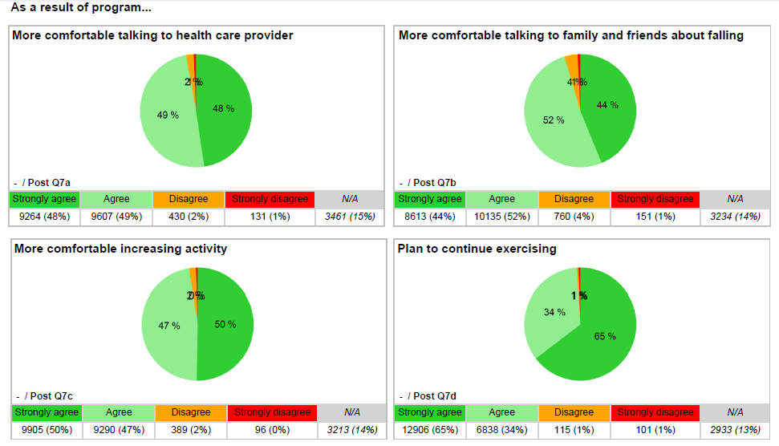
Sample Program Outcome Report
Notes:
Sample

Slide 17
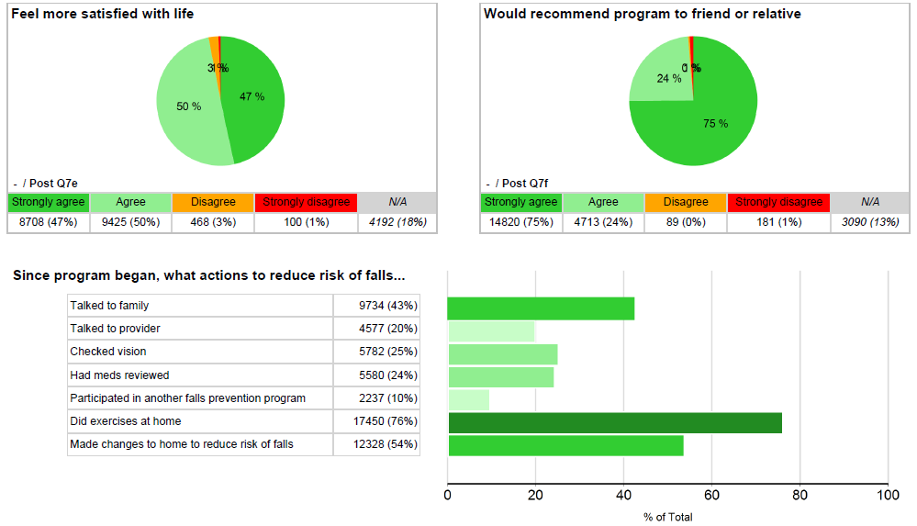
Sample Program Outcome Report
Notes:
Sample

Slide 18
Resources
Falls Prevention Group Leader Script
Tip Sheet: Maximizing Complete and Accurate Data
Tools and Tips Sheets for Hosting a Session Zero
Privacy and Security Basics for Falls Prevention Evidence-Based Programs PowerPoint
[Insert additional resources here]
Notes:
Use the Falls Prevention Group Leader Script to explain the importance of data collection to participants and walk them through the process

Slide 19
Questions?
Contact
[Insert your agency’s contact information here]

