Slide 1
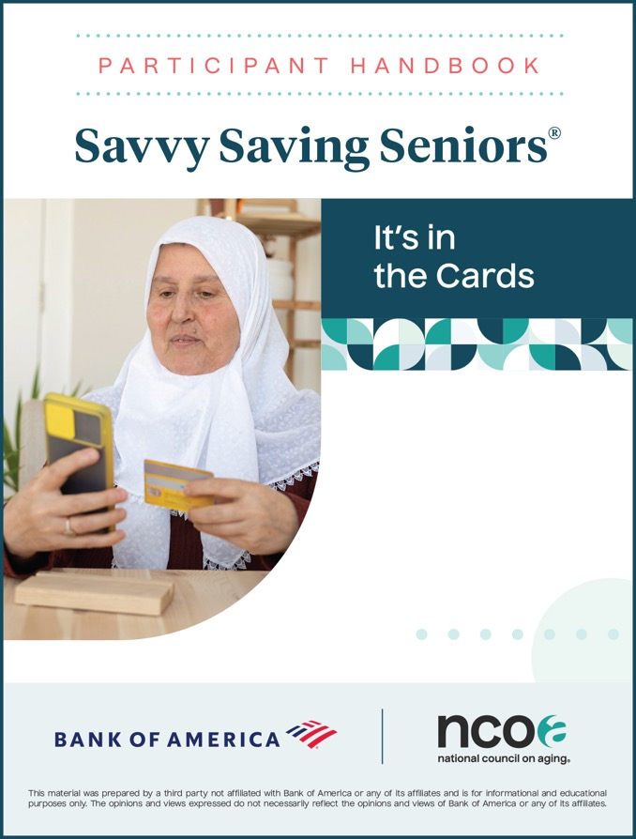

Savvy Saving Seniors®: It’s in the Cards
Welcome
Organization/Event Name
Date

Slide 2



It’s in the Cards: Using Prepaid the Right Way
    Icebreaker Quiz
    Take the quiz in your handbook to see how well you understand prepaid cards.

Slide 3

Takeaways or Personal Goals
    ​____________________________
    ​____________________________
    ​____________________________
    ​____________________________
    ​____________________________

Slide 4


1. Government Benefits Cards Basics
2. Tips for Managing Government Benefits Cards
3. Other Types of Prepaid Cards
4. Tips for Managing Other Types of Prepaid Cards
5. Fees and Costs Associated with Prepaid Cards
6. Tips for Preventing Prepaid Card Scams
Today’s Objectives

Slide 5

Types of Prepaid Cards on the Market
Government Benefits Cards
Reloadable Prepaid Cards
Gift Cards
Payroll Cards

Slide 6

Government Benefits Cards

Slide 7
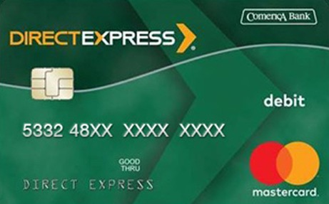

What You Should Know About
Government Benefits Cards
Direct Express
DirectExpress.com and GoDirect.gov
Electronic Benefit Transfer
fns.usda.gov/snap

Slide 8

Tips for Managing Your Government Benefits Cards

Slide 9

How Mary Manages Her Government Benefits Card
    Rent $1,200
    Food $400
    Medicine $25
    Gas $30
    Utilities $82
    Cash $45
    TOTAL $1,782

Slide 10

What About Other Types of Prepaid Cards?

Slide 11

Tips for Managing
Other Prepaid Cards

Slide 12
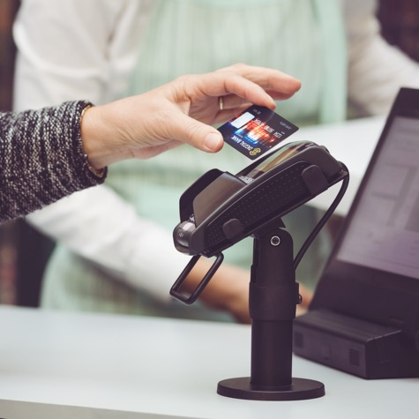
What Are Chip and PIN Cards?

Slide 13



Case Scenario: A Tale of Three Cards
Dorothy
Robert
Martha
A Direct Express card for Social Security benefits
A popular reloadable prepaid card for general purchases
A nonreloadable gift card
Fees to Consider and Compare

Slide 14

Tips from You
    ​____________________________
    ​____________________________
    ​____________________________
    ​____________________________
    ​____________________________

Slide 15

Cautions and Common Scams

Slide 16

Questions?

Slide 17
For More Information
Company
Contact Name
Address Line
Phone
Fax
Email
Web address here

