Slide 1
Lyft Ridesharing at
[ your Center ]
Speaker | Date

Slide 2




What We Do
Health & Well-Being [add list]
Finances and Resources
[add list]
Lifelong Learning
[add list]
Creativity and Culture
[add list]

Slide 3
Transportation Options at [your center]
Daily Van Route
[ Your center} has daily rides to [the center, grocery shopping and medical appointments – insert your options]. Rides must be scheduled [xx] hours before the trip. To make a reservation call [xxx-xxxx].
Free Ridesharing Trips
In partnership with Lyft and NCOA we are offering a limited amount of ridesharing opportunities for those individuals who would like to test and give feedback to this pilot program. Please call [xxx-xxxx] to sign up to learn more.
Public Transportation
Ask the front desk staff for a copy of our public transportation options. These affordable options are offered x days a week and access many needed services.
Trips and Excursions
We partner with [travel company] to offer affordable day trips and longer excursions. Go to www.xxx to learn more about our fun trip program.

Slide 4
Who Uses [insert the local name of your ridesharing program]?
Female
Low Income
Widowed
Lives Alone
Our Typical Rider is: xx Years Old
Adults 60 years or who are mentally alert and ambulatory.
Uses Ambulation Aides:
cane, walker, or collapsible wheelchair (Riders must be able to transfer in and out of the vehicle unassisted. Caregivers may enroll to accompany or assist on all rides.)
X,xxx older adults currently enrolled

Slide 5

Free Rides!
Powered by strong organizations
Ride with confidence
Socialize
Be a part of something new
No cell phone necessary
No cost to you

Slide 6
Ride Share Rules Of Thumb
Lyft Drivers
Rider Responsibilities
Lyft drivers are screened and vehicles have minimum age requirements.
Driver boundaries: waiting five minutes, text message and appropriate interactions
Tolls and handicapped Placards
Pets, extra passengers and caregivers
Tips or gratuities are welcomes but not expected
[add the name of your program]
Office Hours: [add your hours] Mon—Fri: 8am—7pm xxx-xxx-xxxx
On-Call Supervisor xxx-xxx-xxxx
No “Hands On” Assisting Emergency: Call 911
Notes:
•Tolls and handicapped Placards
Tolls: For Concierge rides, just a reminder that tolls will be automatically charged back to the Concierge account, so a rider won't pay for it. But for rides that a rider is taking on their own app, a great call-out reminder!
•Pets, extra passengers and caregivers
Can refer to the non-service animal (pets) guide here. Essentially, it's up to the driver if they want to take a non-service animal, so we encourage riders who wish to bring pets to call their driver once they've been "matched" and ask if it's going to be OK. If the driver declines, suggest rider cancel the ride and re-request.
•Tips or gratuities are welcome but not expected
Lyft recommends using the app to tip (as opposed to cash - the fact that it's a "cashless" transaction is not only a convenience factor, but also a safety benefit). A driver won't know whether you did/didn't tip until after they've given your star rating, so don't worry about it affecting your rating. This puts some people at ease!

Slide 7
Bridging the digital Divide
Lyft Platform
Live Monitoring
Communication with Driver and Rider
Immediate or Scheduled Dispatch
Exact navigation
Real Time Routing
Text Messages to Driver

Slide 8
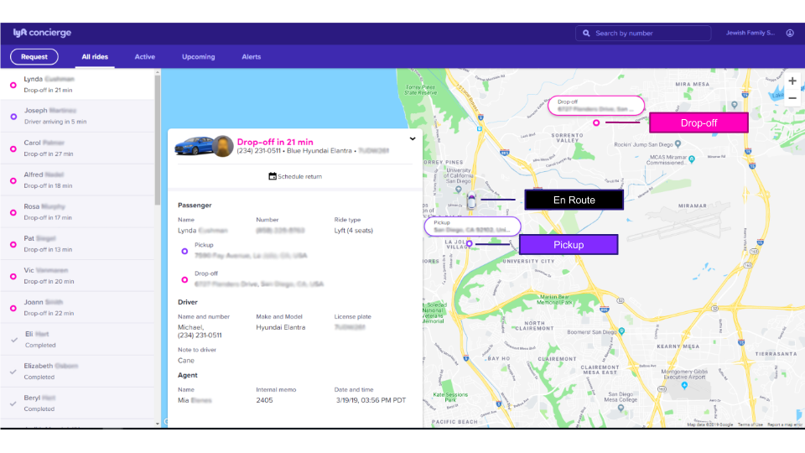

Slide 9
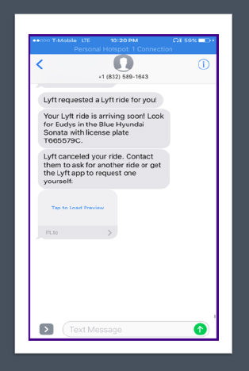
Passenger View
Lyft will send you a text
[title of your ridesharing program lead] will call you
No cell phone? No worries.
[local ridesharing program name] monitors your ride

Slide 10



Ready to Enroll?
Call: xxx-xxx-xxxx and ask for your rides
Contact: Contacts name and title
Direct Line: xxx-xxx-xxxx

Slide 11
Edit your header here
[Your senior center’s name with photo]
Directions to Sign-up
[ Insert your directions and contact information to enroll in your program. ]

Slide 12

SAVE THE DATE
AGE ACTION
JUNE 8–10, 2020
Virtual
AgeAction.org

